Slide 1
Expectantly Waiting on the Lord
Psalm 130
August 20, 2023

Slide 2
Psalm 130
A Song of Ascents ¹ Out of the depths I have cried to You, O Lord. ² Lord, hear my voice! Let Your ears be attentive to the voice of my supplications. ³ If You, Lord, should mark iniquities, O Lord, who could stand? ⁴ But there is forgiveness with You, that You may be feared. ⁵ I wait for the Lord, my soul does wait, and in His word do I hope. ⁶ My soul waits for the Lord more than the watchmen for the morning; Indeed, more than the watchmen for the morning. ⁷ O Israel, hope in the Lord; for with the Lord there is lovingkindness, and with Him is abundant redemption. ⁸ And He will redeem Israel from all his iniquities.

Slide 3
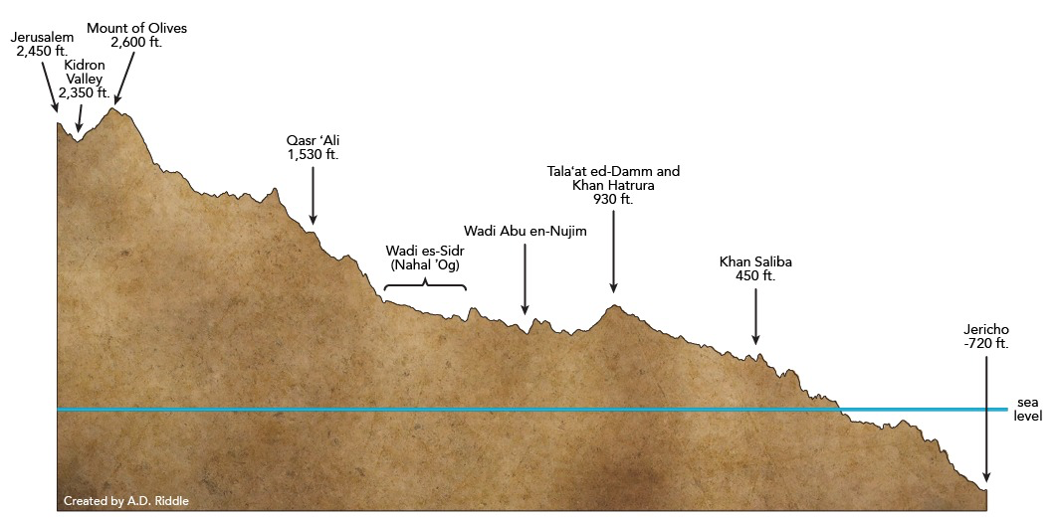

Slide 4
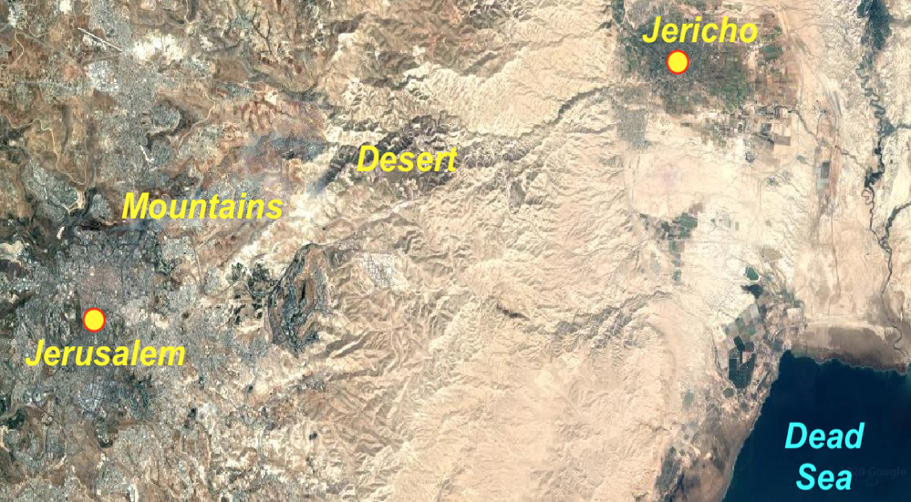

Slide 5
2 Samuel 5:1-4
¹ Then the Lord sent Nathan to David. And he came to him and said, “There were two men in one city, the one rich and the other poor. ² “The rich man had a great many flocks and herds. ³ “But the poor man had nothing except one little ewe lamb which he bought and nourished; and it grew up together with him and his children. It would eat of his bread and drink of his cup and lie in his bosom, and was like a daughter to him. ⁴ “Now a traveler came to the rich man, and he was unwilling to take from his own flock or his own herd, to prepare for the wayfarer who had come to him; rather he took the poor man’s ewe lamb and prepared it for the man who had come to him.”

Slide 6
2 Samuel 5:5-7
⁵ Then David’s anger burned greatly against the man, and he said to Nathan, “As the Lord lives, surely the man who has done this deserves to die. ⁶ He must make restitution for the lamb fourfold, because he did this thing and had no compassion.” ⁷ Nathan then said to David, “You are the man!

Slide 7
Expectantly Waiting on the Lord
I. Urgent prayer to the Lord (1-2)
¹ Out of the depths I have cried to You, O Lord. ² Lord, hear my voice! Let Your ears be attentive to the voice of my supplications.

Slide 8
Romans 8:28
And we know that God causes all things to work together for good to those who love God, to those who are called according to His purpose.

Slide 9
Expectantly Waiting on the Lord
I. Urgent prayer to the Lord (1-2)
¹ Out of the depths I have cried to You, O Lord. ² Lord, hear my voice! Let Your ears be attentive to the voice of my supplications.

Slide 10
Expectantly Waiting on the Lord
I. Urgent prayer to the Lord (1-2)
II. Magnified forgiveness of the Lord (3-4)
³ If You, Lord, should mark iniquities, O Lord, who could stand? ⁴ But there is forgiveness with You, that You may be feared.

Slide 11
Psalm 76:7
You, even You, are to be feared; and who may stand in Your presence when once You are angry?

Slide 12
Expectantly Waiting on the Lord
I. Urgent prayer to the Lord (1-2)
II. Magnified forgiveness of the Lord (3-4)
³ If You, Lord, should mark iniquities, O Lord, who could stand? ⁴ But there is forgiveness with You, that You may be feared.

Slide 13
Expectantly Waiting on the Lord
Jonah 2:9
But I will sacrifice to You with the voice of thanksgiving. That which I have vowed I will pay. Salvation is from the Lord.
John 14:6
Jesus said to him, “I am the way, and the truth, and the life; no one comes to the Father but through Me.
John 10:9
I am the door; if anyone enters through Me, he will be saved, and will go in and out and find pasture.

Slide 14
Expectantly Waiting on the Lord
I. Urgent prayer to the Lord (1-2)
II. Magnified forgiveness of the Lord (3-4)
III. Patiently waiting on the Lord (5-6)
⁵ I wait for the Lord, my soul does wait, and in His word do I hope. ⁶ My soul waits for the Lord more than the watchmen for the morning; Indeed, more than the watchmen for the morning.

Slide 15
2 Corinthians 4:17
For momentary, light affliction is producing for us an eternal weight of glory far beyond all comparison.

Slide 16
Expectantly Waiting on the Lord
I. Urgent prayer to the Lord (1-2)
II. Magnified forgiveness of the Lord (3-4)
III. Patiently waiting on the Lord (5-6)
⁵ I wait for the Lord, my soul does wait, and in His word do I hope. ⁶ My soul waits for the Lord more than the watchmen for the morning; Indeed, more than the watchmen for the morning.

Slide 17
Expectantly Waiting on the Lord
I. Urgent prayer to the Lord (1-2)
II. Magnified forgiveness of the Lord (3-4)
III. Patiently waiting on the Lord (5-6)
IV. Unique hope found in the Lord (7-8)
⁷ O Israel, hope in the Lord; for with the Lord there is lovingkindness, and with Him is abundant redemption. ⁸ And He will redeem Israel from all his iniquities.

Slide 18
Expectantly Waiting on the Lord
Psalm 130
August 20, 2023

